Slide 1



CREDIT CARD
TRANSACTION
AND
CUSTOMER REPORT

Slide 2

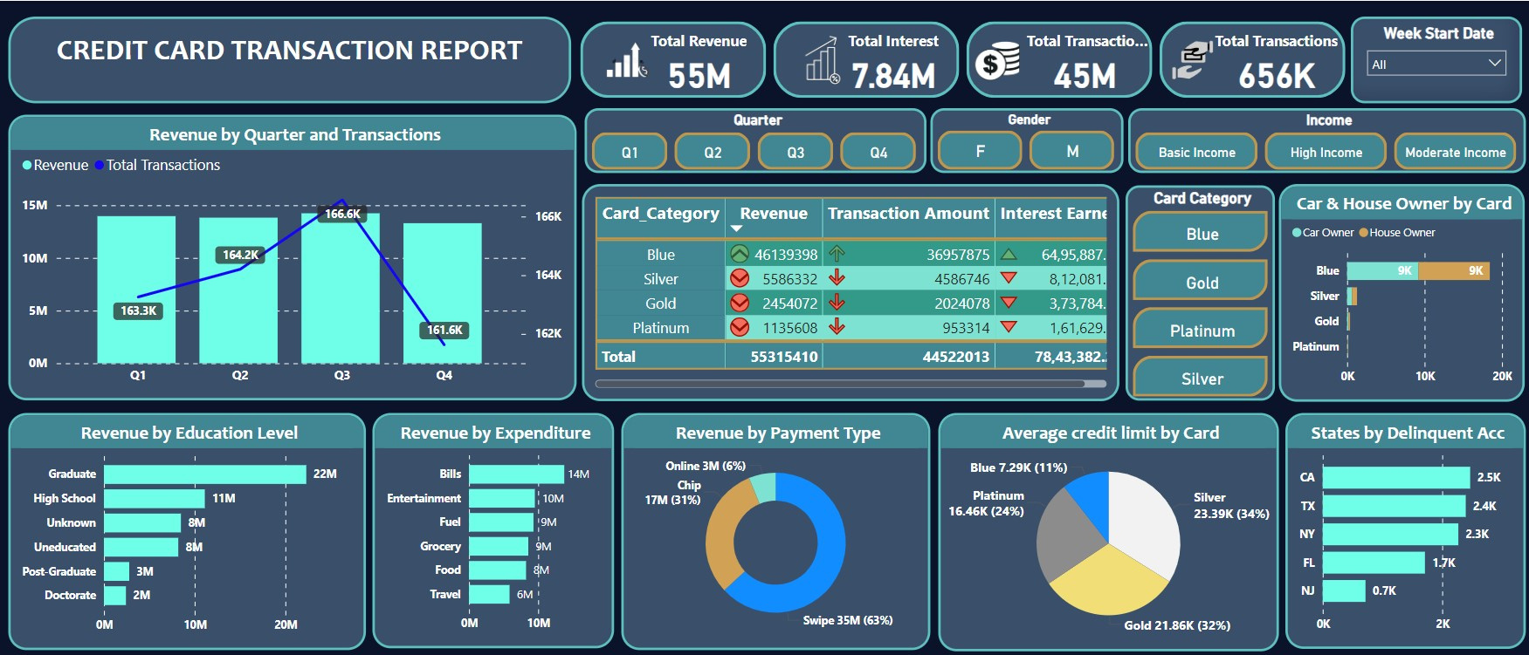


Slide 3
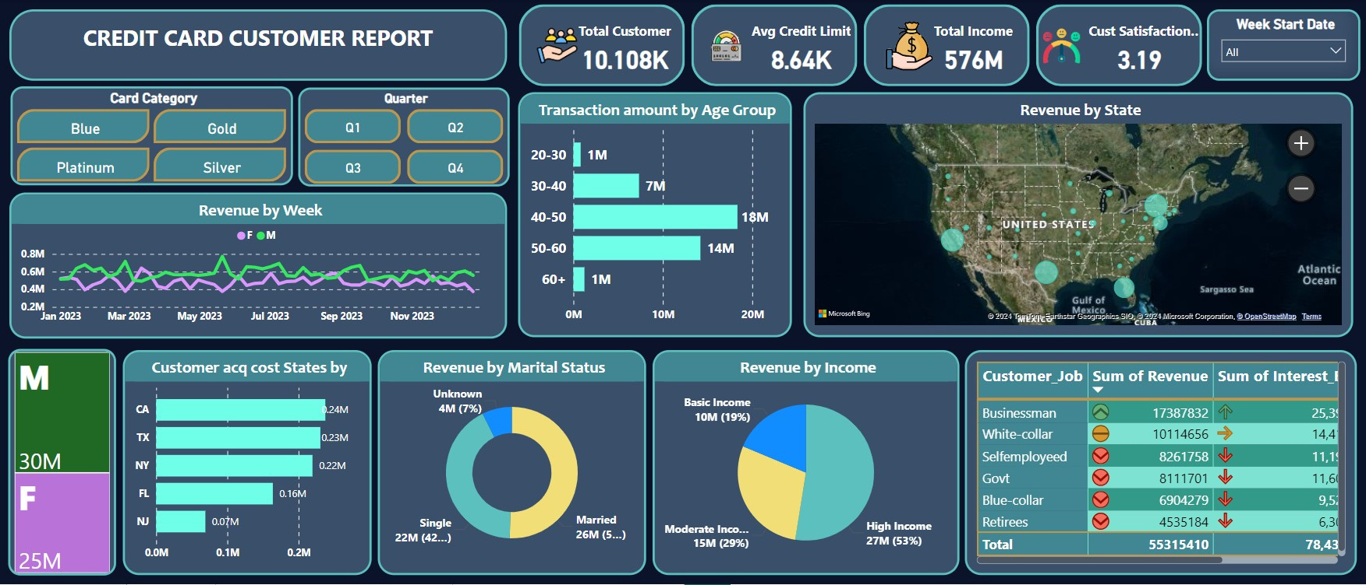

Slide 4


Project Objective
To develop a comprehensive credit
card weekly dashboard that
provides real-time insights into key
performance metrics and trends,
enabling stakeholders to monitor
and analyze credit card operations
effectively.

Slide 5




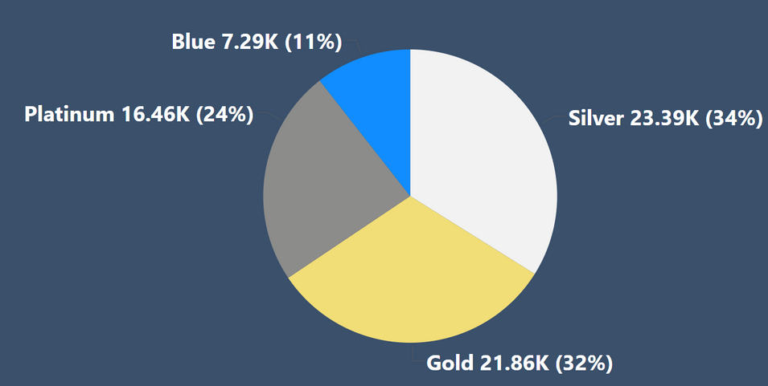

Key Insights
The analysis reveals that the Silver card category holds the highest average credit limit at $23.39k, followed by the Gold card at $21.86k. The Platinum card ranks third with an average credit limit of $16.46k, while the Blue card category has the lowest average credit limit at $7.29k.
The total revenue generated from credit card transactions are $55 million.

Slide 6


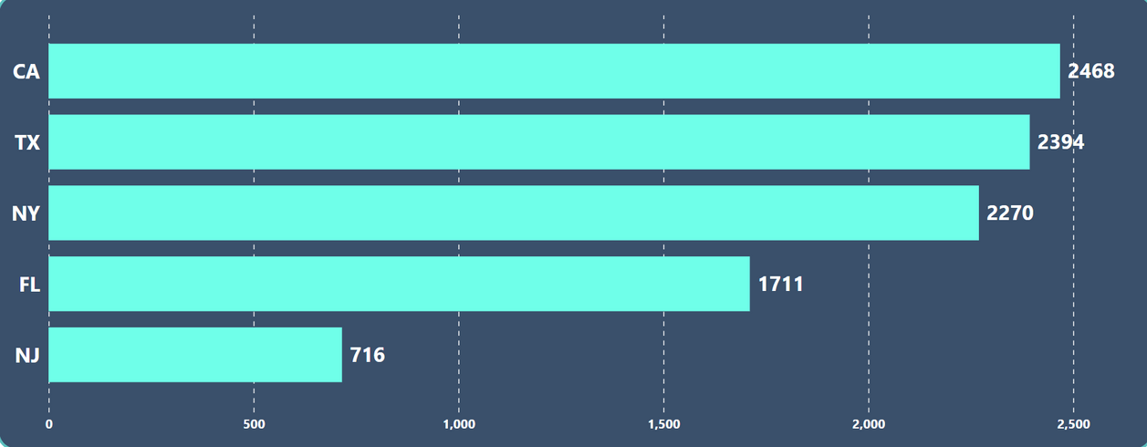
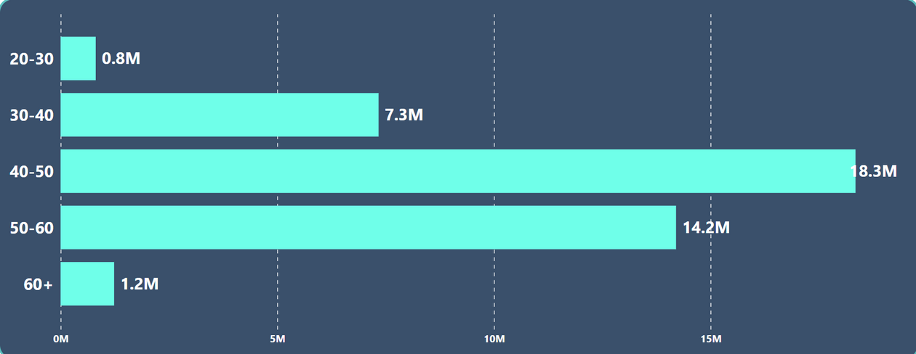
The analysis identifies California (CA) as having the highest number of delinquent accounts at 2,468, followed by Texas (TX) with 2,394 accounts. New York (NY) ranks third with 2,270 accounts, Florida (FL) comes fourth with 1,711 accounts, and New Jersey (NJ) rounds out the top five with 716 delinquent accounts. These findings underscore significant regional challenges in credit management.
The 40-50 age group leads with $80 million in transactions, followed by 50-60 with $14 million, and 30-40 with $7 million. The 20-30 and 60+ groups each contribute $1 million.

Slide 7
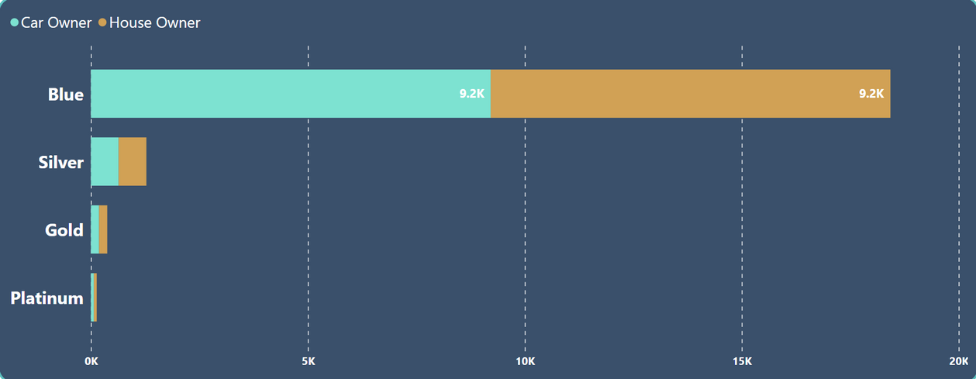

The analysis reveals that Businessmen generate the highest revenue at $17.39 million, followed by White-collar workers with $10.11 million. Self-employed individuals contribute $8.26 million, while Government employees generate $8.11 million in revenue.
The Blue card is the most popular choice among car and house owners, indicating a strong preference for this card category among those with vehicle and property ownership.

Slide 8
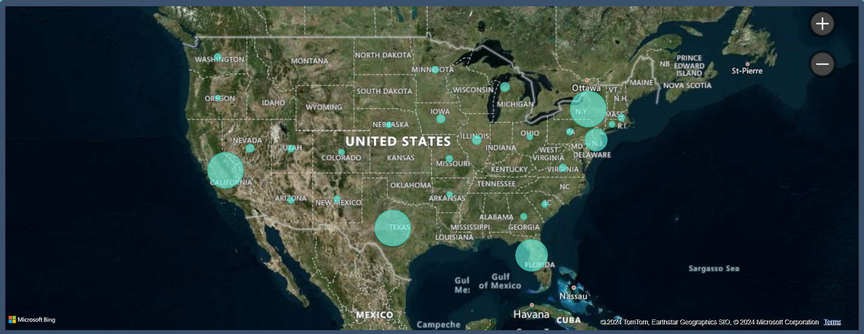
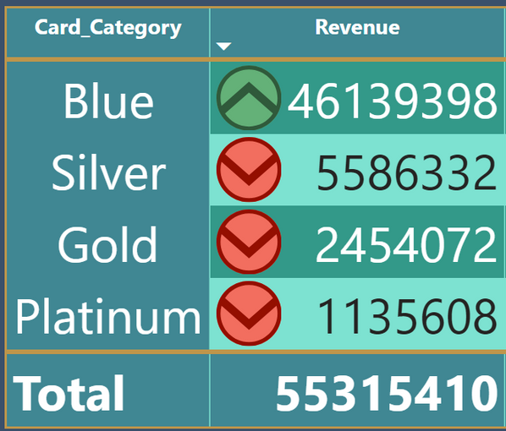
The Blue card stands out as the top revenue generator with $46.14 million, significantly outperforming the Silver card at $5.59 million, the Gold card at $2.45 million, and the Platinum card at $1.14 million. This indicates a strong customer preference and frequent usage of the Blue card.
Texas (TX) leads with $12.81 million in revenue, followed closely by New York (NY) with $12.73 million and California (CA) with $12.62 million. Florida (FL) contributes $9.69 million, while New Jersey (NJ) rounds out the top five with $4.25 million.

Slide 9

















Thank you very much!
jayendranaik00@gmail.com
https://github.com/jayendranaik
www.linkedin.com/in/jayendranaik032002

